Slide 1
Chapter 10
SQL Programming Techniques
4003 3.Embedded SQL

Slide 2
DBMS and SQL
provides SQL or PL/SQL to access the DB that supports:
Data Definition Language (DDL)
create, drop, and alter schema, integrity constraints, views
Data Manipulation Language (DML)
insert, delete and update tuples
Query Language (QL)
select part of tuples satisfying some conditions.

Slide 3
Generations of Programming Languages
1st generation language (1GL)
Machine languages
2nd generation language (2GL)
Assembly languages
3rd generation language (3GL)
High-level procedural programming language: C, Java
4th generation language (4GL)
Declarative in nature such as SQL
Specify what to do rather than how to do:
SELECT * FROM Student;
Simpler to use and have fewer commands
Insulate the user from the data structures and algorithms
Each generations provides a higher level of abstraction of the internal computer hardware details, making the language more programmer-friendly, powerful and versatile

Slide 4






Database Applications
Application
Application
Database
Database

Slide 5
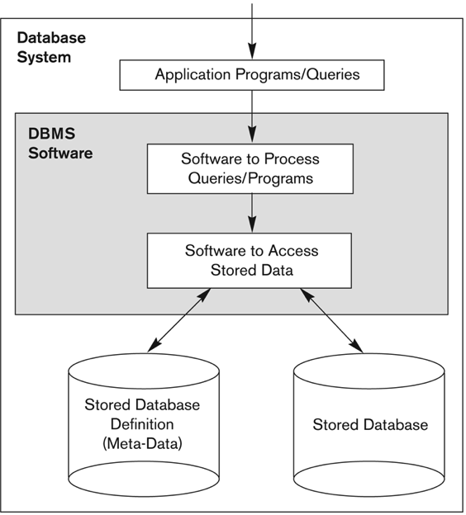
Database System
Application
Database

Slide 6
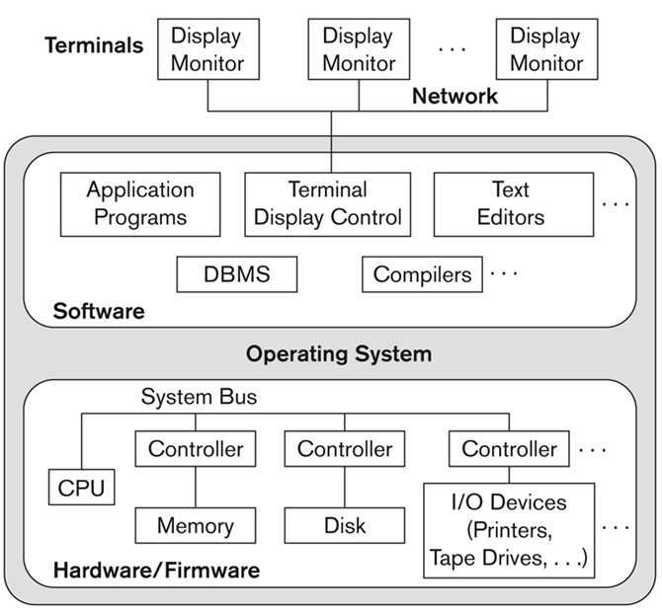
Physical Centralized Architecture

Slide 7
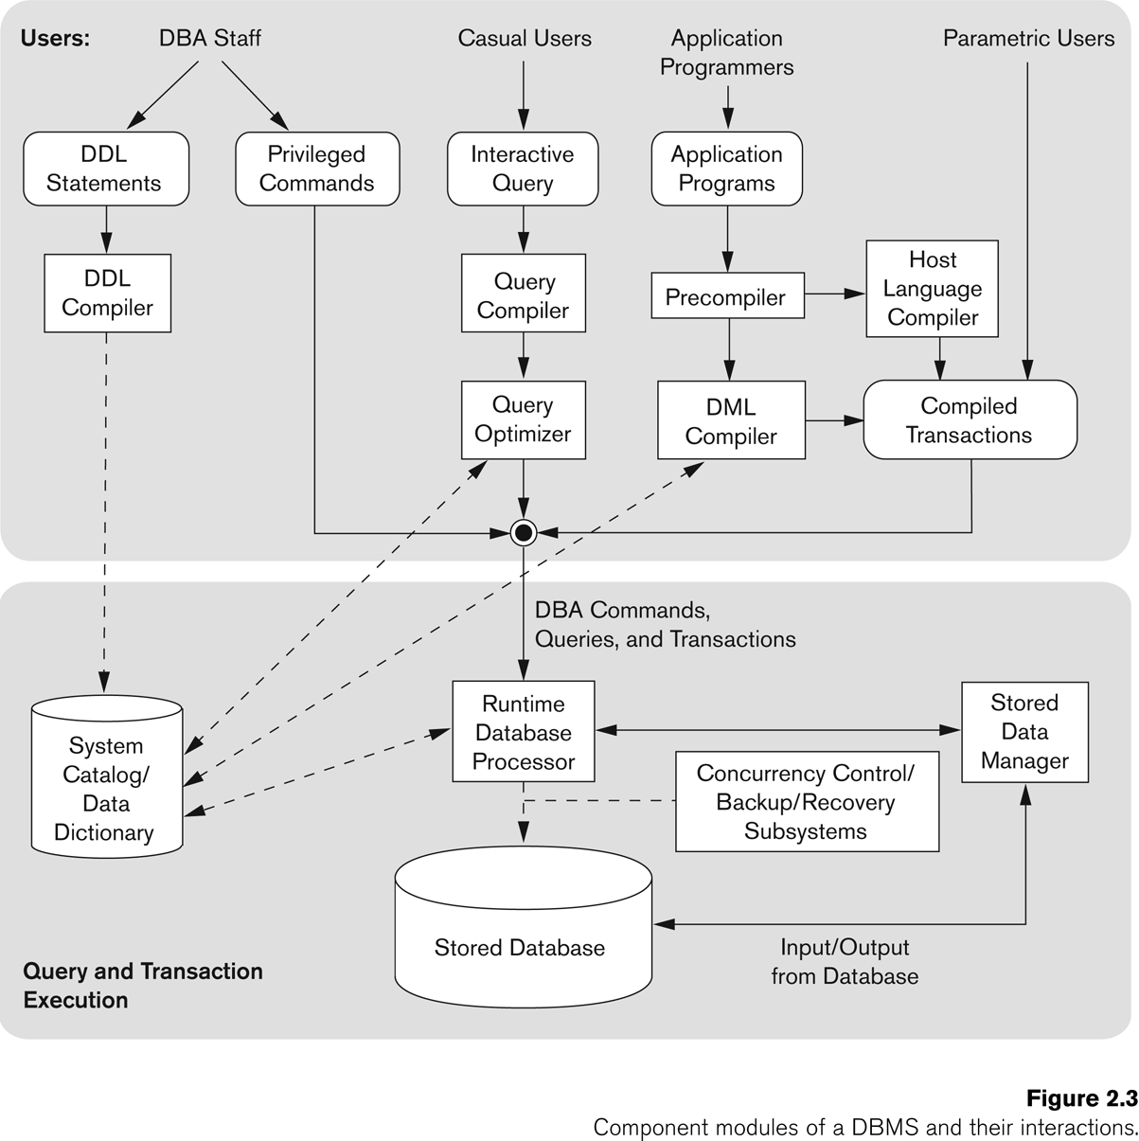
End Users

Slide 8
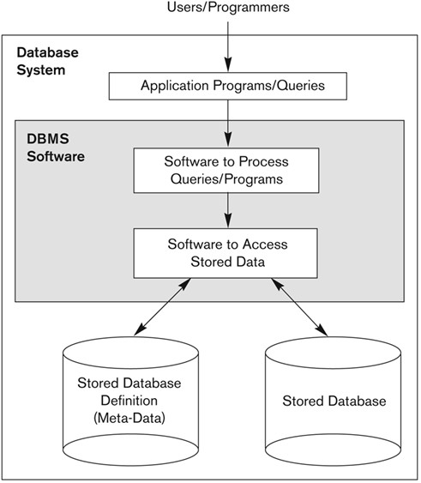
Database Architecture
C,Java,SQLJ

Slide 9

Client-Server Architecture
Application
Program
Client
SQL
SQL
Engine
Application
Server
Database
DB

Slide 10

Logical Two-Tier Architecture
Client
Client
SQL
Network
SQL
DBMS
Server

Slide 11
Database Programming Techniques
Embedded SQL
Dynamic SQL
JDBC
PL/SQL
SQLJ

Slide 12
DBMS
Provides SQL to access the DB that supports:
data definition: DDL
create, drop, and alter schema, integrity constraints, views
data manipulation: DML
insert, delete and update tuples
query: QL
select tuples

Slide 13
What is lacking?
DB Server can only be accessed with SQL
SQL is not a complete programming language, cannot be used to program the application
We cannot use SQL to write sophisticated applications that interact with the users and also DBMS
End users do not use SQL to access the DB as they normally do not know how to use SQL
Nice graphical user interface is needed for end users
Other programming tasks need to be performed

Slide 14
Database Programming
SQL is a language to access database on server
It is not a complete programming language
No variables and types
No input/output statements
No control constructs
No if then else statement
No loop
No error handling
No procedures, functions, packages
End users cannot use SQL to query database

Slide 15
Database Programming
Objective:
To access a database from an application program (as opposed to interactive interfaces)
Why?
An interactive interface is convenient but not sufficient
A majority of database operations are made through application programs (increasingly through web applications)
Use SQL to access the DB, C, java, etc. to do other things

Slide 16
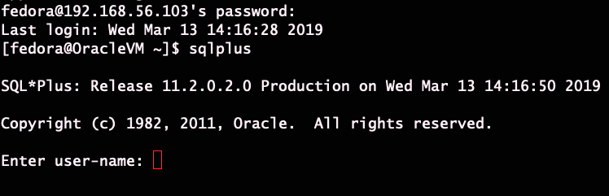
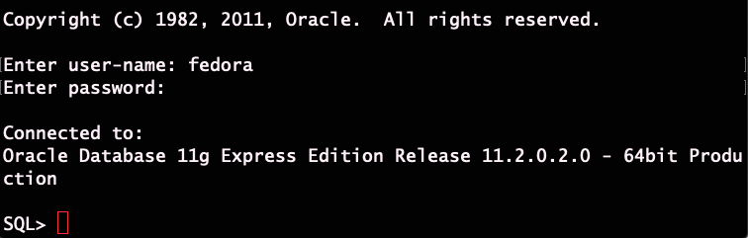
Database Connection

Slide 17
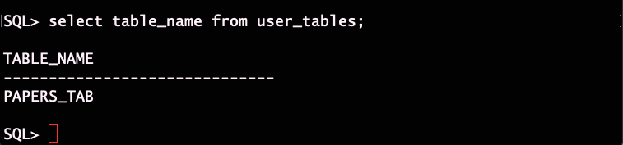
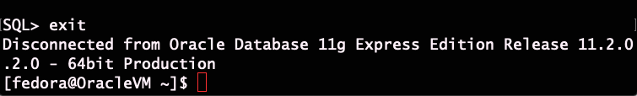
Database Connection 2

Slide 18
Steps in Database Programming
Start the client program
Client program opens a connection to the database server
Login to the server
Client program submits a SQL QL or DML to query and/or updates the database
Database server sends the result back to the client
Client program processes the result
Client program closes (terminates) the connection when database access is no longer needed

Slide 19
Database Programming Approaches
Statement Level Interface (SLI)
Call Level Interface (CLI)

Slide 20
Database Programming Approaches
Embedded commands: (Embedded SQL)
Database commands are embedded in a general-purpose programming language
Library of database functions: (JDBC)
Available to the host language for database calls; known as an API
API standards for Application Program Interface
A brand new, full-fledged language (SQLJ)
Minimizes impedance mismatch

Slide 21
Embedded SQL
Embed SQL in a general-purpose host programming language such as COBOL, C, Java
A program can now have two kinds of statements
normal programming language statements
embedded SQL statements
Any problem?
If we compile this program, what will happen?
Solution:
Distinguish SQL statements from normal programming statements.
Embedded SQL statements are prefixed by "exec sql“

Slide 22
Embedded SQL
Embed SQL in a general-purpose host programming language such as C/C++, Java
A program can now have two kinds of statements
normal programming language statements
embedded SQL statements
Student
S# | SNAME | AGE
1000 | John | 25
2000 | Kate | 24
3000 | Tony | 20
int main() {
...
exec sql
select sname, age
from student
where s# = ‘1000’;
while (…) {
...
}

Slide 23
Embedded SQL
int main() {
...
exec sql
select sname, age
from student
where s# = ‘1000’;
while (…) {
}
Student
S# | SNAME | AGE
1000 | John | 25
2000 | Kate | 30
3000 | Tony | 20
Any problem?
If we compile this program, what will happen?
What is the output of this program?
Solution:
Distinguish SQL statements from normal programming statements.
Embedded SQL statements are prefixed by "exec sql“

Slide 24
Embedded SQL
Application program is a mixture of host language statements and SQL statements and directives
- (Static) Embedded SQL; standardized
hardcode SQL into program
- Dynamic (Embedded) SQL
can generate flexible SQL queries at run-time
Pre-compilation necessary
translates the embedded SQL statements into
standard runtime library calls, and generates a
modified source program that can be compiled

Slide 25
Variable Declaration
DBMS and program need to communicate and exchange values using variables
We need to get tuples from DB into variables or use values in variables for SQL.
We have attributes and variables in SQL statement, how to distinguish them?
exec sql select sname, age
from student
where s# = sno;
What is variable and what is attribute here?
Variables inside DECLARE are shared and can appear (while prefixed by a colon) in SQL statements

Slide 26
Solution
exec sql select sname, age
from student
where s# = sno;
In embedded SQL statement, program variables are prefixed with a colon (:)
exec sql select sname, age
from student
where s# = :sno;
Any problem with this statement?
What is the status of the execution?
Where to get the query result

Slide 27
Query Result
Given a select statement, the result if any will be on the server.
exec sql select sname, age
from student
where s# = :sno;
We need to use variables to hold the result if possible
exec sql select sname, age
into :sname, :age
from student
where s# = :sno

Slide 28
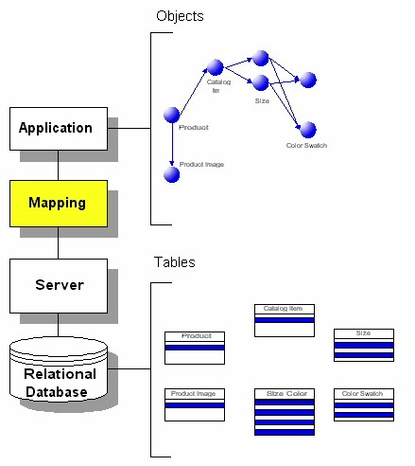
Impedance Mismatch

Slide 29
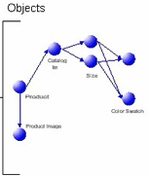
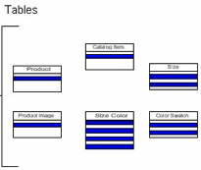
Objects in Relational DB
To put objects into relational databases, they must be described in terms of simple string, integer, or real number data.
Eg. in the case of an airplane.
The wing may be placed in one table with rows and columns describing its dimensions and characteristics.
The fuselage may be in another table,
The propeller in another table,
The tires, and so on.

Slide 30
Impedance Mismatch
Complex objects in emerging DBMS applications cannot be effectively represented as records in relational model.
Representing information in RDBMSs requires complex and inefficient conversion into and from the relational model to the application programming language
Data representation mismatch
Notes:
ODBMSs provide a direct representation of objects to DBMSs overcoming the impedance mismatch problem

Slide 31
Impedance Mismatch
Sometimes, it is impossible to use variables as a SQL query can generate a list of results
exec sql select S#,Sname, Age
into :sno, :sname, :age
from student;
SQL is 4GL which is set at a time processing
C is 3GL which is record at a time processing
When we combine them together, we have this impedance mismatch problem.

Slide 32
Impedance Mismatch (3)
Impedance mismatch occurs between the database and application programs.
Program variables can only hold one tuple at a time
SQL queries can generate a list of results
exec sql select s#, sname, age
into :sno, :sname, :age
from student
set vs. record-at-a-time processing
Data processing mismatch
Client
Client
Network
DBMS
Server

Slide 33
Solution
Use the cursor mechanism and special iterators to loop over query results.
A cursor (iterator) specifies a query that may have a set of tuples.
exec sql declare s-cursor cursor for
select s#, sname, age
from student;
exec sql open s-cursor;
…
exec sql close s-cursor;
Client
Client
Network
DBMS
Server
The result is in main memory on the server
The result on the server is erased
Notes:
tells the server that the processing of query results has been completed and result in server memory can be erased

Slide 34
Embedded SQL in C Programs
A cursor (iterator) is needed to process multiple tuples
FETCH commands get a tuple from server memory to client memory and move the cursor to the next tuple
CLOSE CURSOR indicates that the processing of query results has been completed and result in server memory can be erased
Client
Client
Network
DBMS
Server

Slide 35
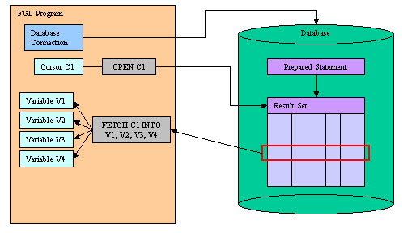
Embedded SQL in C Programs
CLOSE C1
Client
Server

Slide 36
Cursor Example (cursor.pc) Highlight
exec sql begin declare section;
all variables needed
exec sql end declare section;
exec sql declare scursor cursor for
select s#, sname, age
from student;
exec sql whenever sqlerror goto error;
exec sql whenever not found do break;
exec sql open s-cursor;
loop
exec sql fetch s-cursor into :sno,:sname,:age;
exec sql close s-cursor;
Client
Client
Network
DBMS
Server

Slide 37
Cursor Example (cursor.pc)
#include <stdio.h>
main() {
exec sql include sqlca;
exec sql begin declare section;
char sno[5];
char sname[20];
int age;
char *MYID= "fedora/oracle";
exec sql end declare section;
Client
Client
Network
DBMS
Server

Slide 38
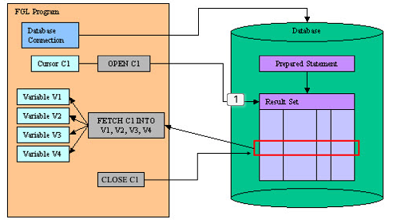
Cursor Example (cursor.pc)
exec sql declare scursor cursor for
select *
from Student;
exec sql whenever sqlerror goto error;
exec sql whenever not found do break;
exec sql connect :MYID;
printf("Connected to ORACLE\n");
exec sql open scursor;
printf("Cursor opened\n");
Client
Client
Network
DBMS
Server

Slide 39
Cursor Example (cursor.pc)
while(1) {
exec sql fetch s_cursor
into :sno, :sname, :age;
printf("%4s %10s %11d\n", sno, sname, age);
}
done:
exec sql close s_cursor;
exec sql commit release;
printf(”Successfully!\n");
exit(0);
Client
Client
Network
DBMS
Server

Slide 40
Cursor Example (cursor.pc)
error:
printf(“SQL errors!\n”);
exec sql rollback release;
exit(1);
}
Client
Client
Network
DBMS
Server

Slide 41
Database Connection
If we type sqlplus, it will prompt for username and password
Then we can issue DDL, DML, QL commands
In Embedded SQL, we also need to send username and password to setup connection.
Then we use embed SQL commands

Slide 42
How to connect to the server
Use one variable for username and password
exec sql begin declare section;
char *MYID= "fedora/oracle";
exec sql end declare section;
exec sql connect :MYID;
Use two variables for username and password
exec sql begin declare section;
char *username= "fedora ";
char *password= "oracle";
exec sql end declare section;
exec sql connect :username identified by :password;

Slide 43
Embedded SQL Program Structure
Declaration Section
Database Connection Section
Database Manipulation Section
Database Disconnect Section
Error Handling Section

Slide 44
Declaration Section
exec sql begin declare section;
char sno[4];
char sname[20];
int age;
char *MYID= "fedora/oracle";
exec sql end declare section;
exec sql declare s-cursor cursor for
select s#, sname, age
from student;
exec sql whenever sqlerror goto error;
exec sql whenever not found do break;

Slide 45
Database Connection Section
exec sql connect :MYID;
or
exec sql connect :username identified by :password;
if (sqlca.sqlcode == 0)
printf("Connect to ORACLE\n");
else
printf("Connect Failed\n");

Slide 46
Query & Manipulation Section
exec sql open s-cursor;
while(1) {
exec sql fetch s_cursor
into :sno, :sname, :age;
printf("%4s %10s %11d\n", sno, sname, age);
}

Slide 47
Database Disconnect Section
exec sql close s_cursor;
exec sql commit release;
printf("Work is done successfully!\n");
exit(0);

Slide 48
Error Processing Section
Oracle reports any errors or warnings in SQLCA
Two way to handle errors
explicit handling
writing code to check the sqlca structure and takes appropriate action
implicit handling
using the whenever statement

